Slide 1

Module Federation

Slide 2
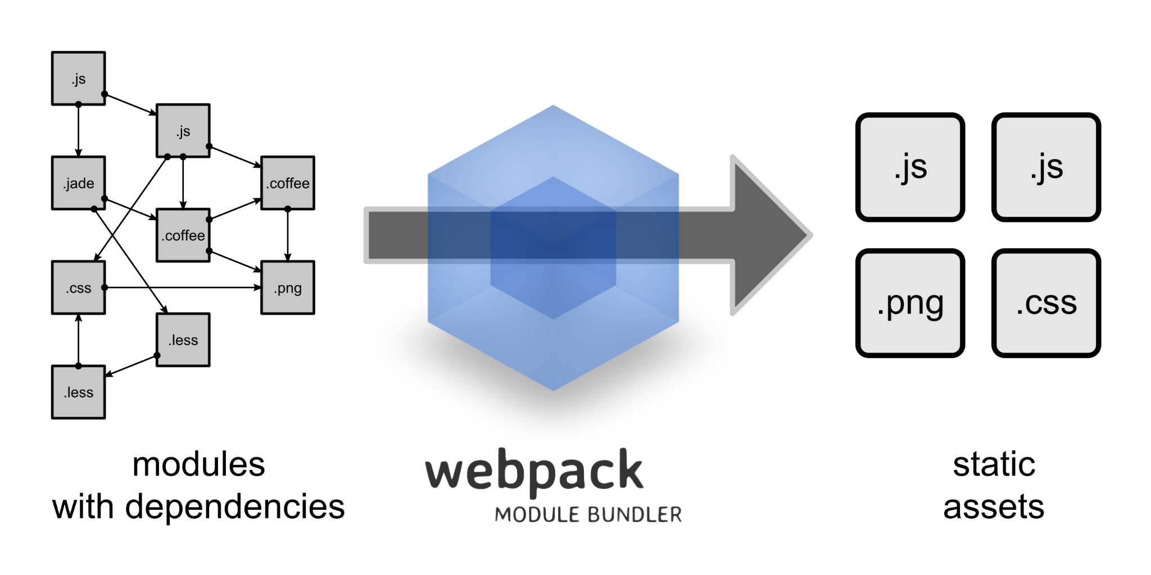
What is webpack?
Webpack is a module bundler for JavaScript applications. It takes all the individual modules (JavaScript, CSS, images, etc.) in a project and bundles them into a few optimized static assets (bundles) that can be used by a browser. Essentially, it helps manage and optimize the various files that make up a web application, making it easier to develop and deploy.

Slide 3

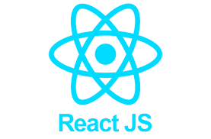

Module Federation:
Multiple separate builds should form a single application. These separate builds act like containers and can expose and consume code among themselves, creating a single, unified application.

Slide 4
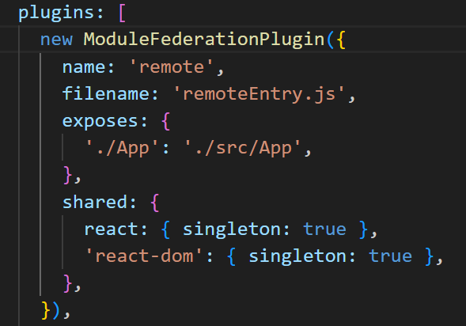
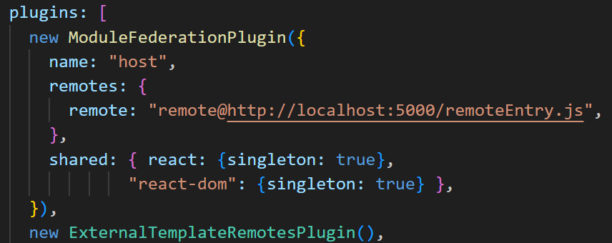
Configuration
Remote App
Host App

Slide 5
Lazy Loading
It defers the loading of components or resources until they are actually needed, rather than loading everything upfront.
This approach helps reduce the initial load time of a React application, improving user experience and overall performance, especially in large-scale applications.
React provides built-in features to facilitate lazy loading
React.lazy(): This function allows you to dynamically import a component, meaning its code is loaded only when the component is rendered for the first time.
Suspense: This component is used in conjunction with React.lazy() to handle the loading state while the lazy-loaded component is being fetched. It takes a fallback prop, which is a React element to display while the component is loading.

Slide 6
Error Boundaries
React components that are designed to catch JavaScript errors that occur within their child component tree during rendering, in lifecycle methods, and in constructors. When an error is caught, an error boundary can display a fallback UI instead of the component tree that crashed, preventing the entire application from breaking and enhancing the user experience.
An error boundary is typically implemented as a class component with at least one of these static lifecycle methods:
static getDerivedStateFromError(error): This method is called after an error is thrown by a descendant component. It should return an object to update state, allowing the error boundary to display a fallback UI.
componentDidCatch(error, errorInfo): This method is called after an error is thrown. It is used for side effects, such as logging the error information to an external service.

Slide 7
Pros
Runtime Integration – Import remote components after both apps are built
Independent Deployment – Teams can ship apps on separate pipelines
Code Sharing – Share common libraries (React, lodash) to reduce duplication
No iframes or wrappers – Native component integration, not isolated like Web Components
No import maps needed – Webpack handles all the resolution logic
Works across frameworks – Can be used in React, Angular, Vue, even Web Components

Slide 8
Cons
Tied to Webpack – Federation is Webpack-specific (Vite/Rollup alternatives exist but are not native)
Initial setup is complicated – Requires per-app Webpack configuration and shared dependency coordination
Runtime failures are possible – If the remote is down, the host may break unless you handle fallbacks
Version mismatch risks – Shared libs (like React) must be tightly versioned and aligned
No automatic SSR – Requires custom hydration logic for federated components

Slide 9
Thank You

